Slide 1
Workbook Company Overview
Internal Use Only
April 2017
EXCEL FILE:

Slide 2
Disclaimer
The content of this workbook has been produced by KPMG Germany/Deal Advisory on the basis of German accounting standards and/or IFRS, as well as considering KPMG Germany’s firm and country requirements, regulations, processes, policies and best practices. Please check your local accounting and other requirements before applying the content.

Slide 3
Overview (1/3) – Mission statement
Company Overview
Flag: Tools listed for company overview are commonly used in Germany and may differ in other regions.
Mission Statement:
Solid description and distinction of the object of analysis/transaction/valuation/restructuring as a starting point for subsequent analyses, results and recommendations.
Customer situation
Definition/Methodology/Tools of the basis analysis
Buy Side/Sell Side/JV
Introductory description of the object of analysis/transaction/valuation:
Company profile and historical development
Legal structure/participations
Organizational structure
General legal and fiscal conditions
Business model and value chain
Restructuring/Rapid transformation
Separation of object of restructuring opinion/solvency test/restructuring
Assessment of stage and causes of crisis
Historical development
Site(s)
Methodology
Company presentations & website, audit reports, research in databases
Preparation of company-internal information (also from interviews)
Reproduce the structure of the company to an understandable level – this forms the basis for subsequent analyses
The knowledge of the legal and fiscal conditions is essential for the assessment of the company’s current situation
Tools
Analysis toolbox
Minimum standards for content
Sample slides
Site I
XXX MA
Office
Site II
XXX MA
Office
Foundation
XXXX
Event
XXX
19XX
…
199Y
200Z
Event
XXX
Event
XXX
XX%
XX%
Degree of Standardization
ABC AG
Uniform presentation of company overviews for a number of companies
Adapt degree of detail to complexity (e.g. presentation of heterogeneous segments)
XXX
XXX
201W
201X
201Y
201Z
XXX
XXX
XXX
XXX
Revenue
EBIT margin
Key financials
Organizational structure

Slide 4
Overview (2/3) – Pitfalls
Company Overview
No. | Pitfalls/Lessons learned
 | Too detailed presentation of the history – max. 10-15 events or major stages in the company development.
 | Including detailed information which has to be discussed in detail in subsequent parts of the report or put into the appendix (esp. primary contracts).
 | Neglecting the legal and fiscal conditions in complex corporate structures (esp. Joint liabilities, tax groups, contingencies) – lacking identification of issues as well as hurdles to the implementation of our recommendations.
 | Insufficient analysis of the inter-company relationships (legal/trading/financing/fiscal) leads to a lack of transparency and lacking identification of issues as well as hurdles to the implementation of our recommendations.
 | Keeping obsolete legal and organizational structures while changing functional areas of the company.
 | Misinterpretation of the company’s economic situation leads to management errors – use time lines and competitor benchmarks against market and competitor development to put the development into right perspective.
1
2
3
4
5
6

Slide 5
Overview (3/3) – Core issues (1/2)
Company Overview
Core issue | Specific presentation | Page(s)
What is the object of analysis/transaction/valuation/ restructuring? | Distinction of the legal entities subject to our analysis / transaction / valuation / restructuring. Key facts on the object of examination. | 7, 11, 12
What historical events define the development of the company? | Presentation of the material events on the basis of a historical timeline. Relevant are foundation, major M&A activities, new products/markets, major changes in shareholder/management. | 10, 11
Where does the company have sites? What are their functions? | Presentation of the company’s locations and their functions (e.g. headquarters, production sites, sales offices, F&E). | 8, 9, 11
What is the legal structure of the object, who are the shareholders, what are the functions of the legal entities and their legal relationships? | Presentation of the corporate structure in the form of an organizational chart to identify and distinguish the object of the examination as well as to describe the functions of the legal entities and their relationships. | 7, 12
What is the company’s business model and value chain? | Inventory of the company’s general data, business activities and individual steps of the company’s value chain. Schematic presentation of the company‘s value chain. Presentation of the company‘s primary and secondary activities in a company specific value chain model. Clear presentation of the company‘s position within the industry map - The goal is to identify the critical success factors and the core competencies of the company. What is being bought in? What is being used as input? What output is being sold to whom? | 13-17
How are the individual functional areas (Sales, Admin, etc.) organized? What is the management structure? What are the FTEs? | Presentation of the management structure by functional area and responsibilities. Including FTE numbers and names of managers. | 18
What are the basic legal and fiscal conditions of the object? | Summary of the major contracts (legal and fiscal) to identify current obligations and operating preconditions of the object (e.g. legal disputes, financing agreements, joint liabilities, contingencies, tax groups, profit transfers and control agreements, other agreements such as permissions, rent, leasing, licenses, subsidies). | 19-24
1
2
3
4
5
6
7

Slide 6
Overview (3/3) – Core issues (2/2)
Company Overview
Core issue | Specific presentation | Page(s)
What economic situation is the object currently in? | Overview presentation of the economic situation of the object (earnings, assets & liabilities, financing & liquidity). | 25, 26
RES: what stage of crisis is the object currently in? What are the main causes of crisis? | Determination and presentation of the current stage of crisis and its causes. | 27
8
9

Slide 7
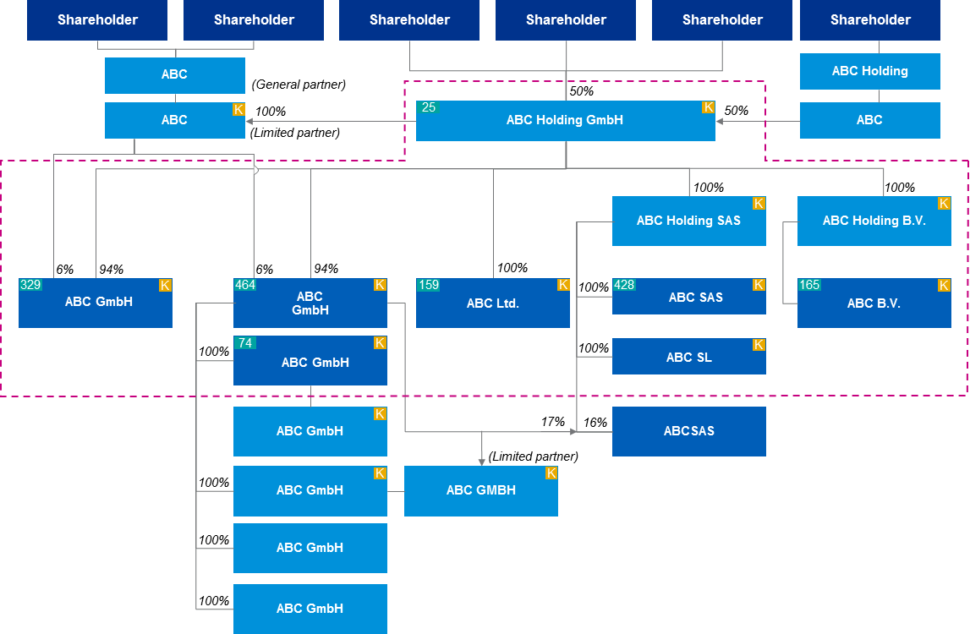
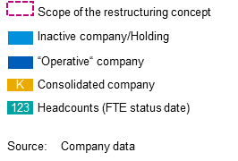
1. Company profile – Overview
Company Overview
Alternative 1
1
4
Object may be: legal entity, group, sub-group, legal entity with subsidiaries
[…Object of analysis…] is located in […] and has generated [€ …m] sales in 20XX with […] employees.
Main locations are […].
Main products/services are […].
Main entities are […].
Key facts
Full name and legal form of the object
Foundation: [YEAR]
Headquarters: [CITY/COUNTRY]
Purpose of the company:
Parent company:
Financial year end:
C-Level Management:
Trade registry: Circuit court of xxx HR- xxxx
Articles of incorporation: xx/xx/201x (last modification xx/xx/201x)
Subscribed capital: € XXX m
Employees/ FTE (as of: xx/xx/201x):
Business activity
Main area of business is [….]
[Segments:
Main product / services:
Regions:
[….]]
Legal structure
Compulsory content:
Key facts
Description of business activity
Legal structure (see Alt. 2 for detailed content)
This is a sample commentary text.
Adapt as applicable.
Tools
General PPT template
Source: Company information, KPMG analysis.
Source: Company information, Audit report for FY20xx

Slide 8
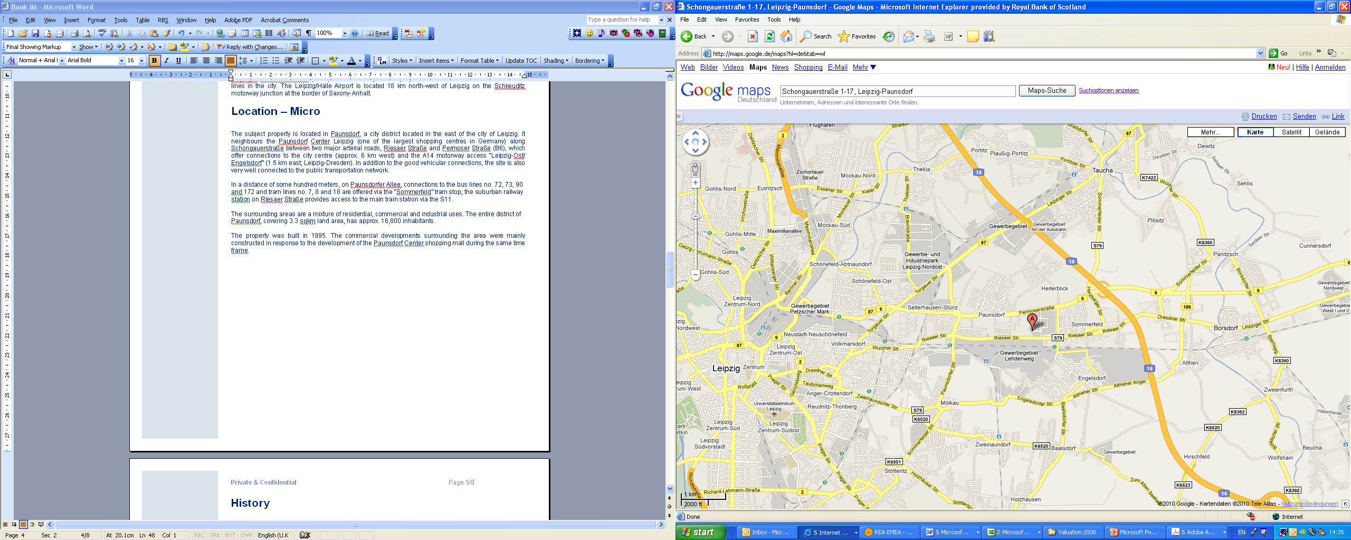
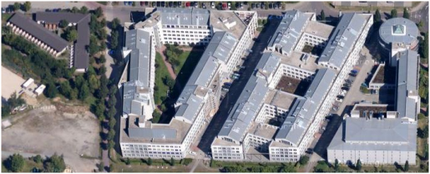
1. Company profile – Locations [Example 1]
Company Overview
Alternative 1
3
The headquarters and administration of the ABC AG is in [CITY, COUNTRY].
At this site there are three production halls and a large warehouse.
In addition, the company has production sites throughout Europe in [....], [...], [...] and in[...].
Production and administrative locations of the ABC Group in the EU
Core segments and office locations
The ABC AG consists of the three segments A, B and C, which are represented in Germany, France, England and Switzerland.
The primary sales channel is [...]. This is supplemented by [...].
The headquarters of the ABC-AG is located in xxxx.
Since 20xx the largest office location is in Hannover.
The European business of the ABC-AG is handled entirely from the German sites.
xxx
Xxx
xxx
xxxx
Key:
Headquarters Offices Production sites
Locations and details
Building A
Production: 17.302 m²
Office: 694 m²
Building B
Production: 19.780 m²
Office: 647 m²
Building C
Production: 7.863 m²
Office: 593 m²
Parking spaces
Underground: 538
Park spaces: 132
Compulsory content:
Headquarters
(Sales) Offices
Production sites
This is a sample commentary text.
Adapt as applicable.
Warehouse
Building A
Building B
Warehouse: 3.985 m²
Building C

Slide 9
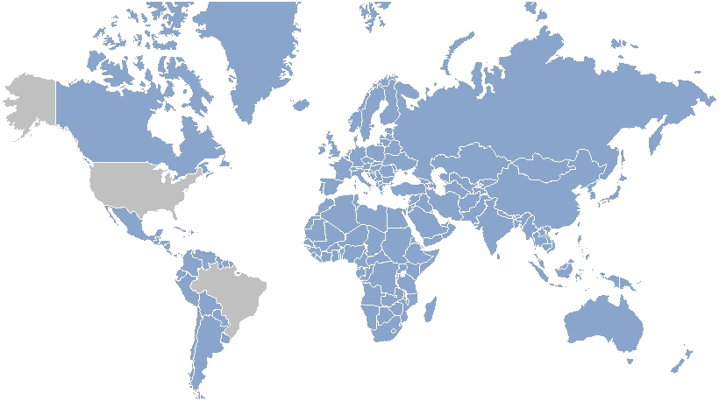
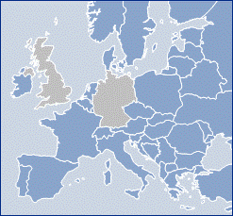











1. Company profile – Locations [Example 2]
Company Overview
Alternative 1
3
ABC group has four production sites, main production activities being performed at the headquarters in Germany.
Subsidiary 3 also has high value added whereas subsidiaries 1 and 2 are used as low cost assembly sites and market entry points.
The group runs eight sales and after sales offices in seven countries.
Subsidiary 1
Headquarters
€m | 2008 | 2009
Sales | 64 | 23
thereof IC | 56 | 21
Gross profit | 14 | 5
EBIT | 1 | -3
Employees | 179 | 99
€m | 2008 | 2009
Sales | 344 | 252
thereof IC | 84 | 38
Gross profit | 156 | 84
EBIT | 10 | -15
Employees | 1.282 | 1.272
Subsidiary 2
€m | 2008 | 2009.
Sales | 37 | 55
thereof IC | 1 | 0
Gross profit | 13 | 14
EBIT | -1 | 1
Employees | 105 | 96
1
2
3
4
5
1
2
3
4
5
1
2
3
4
5
Sales & After Sales
Subsidiary 3
€m | 2008 | 2009
Sales
HWZ | 46 | 28
GSN | 23 | 20
HIT | 11 | 5
HFR | 12 | 6
HES | 2 | 3
HSK | 1 | 1
HMX | - | 0,3
HCN | 1 | 10
€m | 2008 | 2009 preliminary
Sales | 51 | 33
thereof IC | 9 | 6
Gross profit | 23 | 15
EBIT | 2 | 3
Employees | 245 | 175
Compulsory content:
Headquarters
(Sales) Offices
Production sites
This is a sample commentary text.
Adapt as applicable.
ABC Group
€m | 2008 | 2009
Sales | 442 | 376
Gross profit | 257 | 171
EBIT | 22 | -4
1
2
3
4
5
F&E
1
Parts production
2
Module assembly
3
Final assembly
4
Sales & After sales
5
Source: Company information, KPMG analysis.

Slide 10
1. Company profile – Historical development
Company Overview
Alternative 1
2
Timeline from ppt library
After the founding in [...] the [...] entered the stock market. The company was renamed in [...] and carved out the segment [...] to Italy.
By acquiring the US company [...] in 201x the [...] has the possibility to position itself in the [...] segment.
Historical development of the […]
[...]
[...]
[...]
[...]
[...]
[...]
[...]
[...]
[...]
[...]
[...]
[...]
[...]
[...]
[...]
[...]
[...]
[...]
[...]
[...]
[...]
1984
…
1999
2000
…
2006
2007
2008
2009
….
20xx
Founded
[...]
IPO
[...]
[...]
[...]
[...]
[...]
[...]
[…]
[...]
[...]
Comments
The ABC-AG was originally founded in 1984 as xxx.
It made its IPO in 20xx
The company was renamed in xxx
The management changed in xxx
The sale of the segment xxx in 20xx led to xxx
The entry of the holding company xxx as core stockholder
Compulsory content:
Foundation,
Major M&A activities,
New products/markets
Major changes in shareholder/management
This is a sample commentary text.
Adapt as applicable.

Slide 11
1. Company profile – Overview
Company Overview
Alternative 2
1
2
3
Object may be: legal entity, group, sub-group, legal entity with subsidiaries
[…Object of analysis…] is located in […] and has generated [€ …m] sales in 20XX with […] employees.
Main locations are […].
Main products/services are […].
Main entities are […].
Key facts
Full name and legal form of the object
Foundation: [YEAR]
Headquarters: [CITY/COUNTRY]
Purpose of the company:
Parent company:
Financial year end:
C-Level Management:
Trade registry: Circuit court of xxx HR- xxxx
Articles of incorporation: xx/xx/20xx (last modification xx/xx/20xx)
Subscribed capital: € XXX m
Employees/ FTE (as of: xx/xx/20xx):
Locations
[….]
[…]
Key:
Headquarters Offices Partner companies Sales offices
Sales representatives Production site
Historical development of the […]
[...]
[...]
[...]
[...]
[...]
[...]
[...]
[...]
[...]
[...]
[...]
[...]
[...]
[...]
[...]
[...]
[...]
[...]
Compulsory content:
Key facts
Locations (see Alt.1)
Historical development (see Alt. 1 for detailed content)
This is a sample commentary text.
Adapt as applicable.
1984
…
1999
2000
…
2006
2007
2008
2009
….
20xx
Founded
[...]
IPO
[...]
[...]
[...]
[...]
[...]
[...]
[…]
[...]
[...]
Source: Company information, KPMG analysis.

Slide 12
1. Company profile – Legal structure
Company Overview
Alternative 2
1
4
[…]
Shareholder
Shareholder
Shareholder
Shareholder
Shareholder
Shareholder
ABC
ABC Holding
(General partner)
50%
ABC Holding GmbH
ABC
25
K
ABC
K
100%
50%
(Limited partner)
100%
100%
ABC Holding SAS
ABC Holding B.V.
K
K
6%
94%
6%
94%
100%
ABC GmbH
ABC GmbH
ABC Ltd.
ABC SAS
ABC B.V.
329
K
464
K
159
K
100%
428
K
165
K
ABC GmbH
74
K
ABC SL
100%
100%
K
ABC GmbH
ABC SAS
K
17%
16%
Compulsory content:
Scope of analysis
Operative entities
Inactive entities
Shareholdings
FTEs
This is a sample commentary text.
Adapt as applicable.
(Limited partner)
ABC GmbH
ABC GMBH
100%
K
K
Scope of the restructuring concept / transaction
ABC GmbH
Inactive company/Holding
100%
“Operative“ company
K
Consolidated company
100%
ABC GmbH
123
Headcounts (FTE status date)
Source: Company data

Slide 13



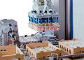
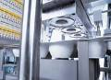
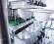
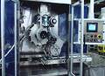
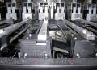
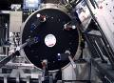
1. Company profile – Business activities [Example 1]
Company Overview
Alternative 1&2
5
Business activities of the ABC group are structured in three segments: Pharma/ Cosmetics, Dairy und Food.
Dairy makes up 42% of total sales and is therefore the biggest segment. Food is more than twice as profitable on EBIT-level.
Inactive subsidiaries as well as the holding are run in the segment Other (not presented on this page).
Segments
Pharma/Cosmetics
Dairy
Food
Products
Fluid Beds
Presses, Coaters
Tube fillers
Aerosol filling machinery
Blisters
Cartons
Palletizers
Cup form-fill-seal machines, Cup/Bottle fill-seal machines for pre-formed cups
Wrapping machines
Tray-erectors, and palletizers for trays, cartons and plastic crates
Cup fill-seal machines
Aerosol filling machinery
General-purpose cartoning and flexible packaging machines
Operating, distribution and service units
[…] […] […] […] […] […] […] | (GER) (GER) (UK) (UK) (UK) (BRA) (THAI)
[…] […] […] […] […] […] […] | (GER) (GER) (GER) (GER) (F) (ESP) (GER)
[…] […] […] […] […] | (USA) (USA) (ARG) (IND)
Compulsory content:
Segments/regions/countries – whatever is applicable
Products/Services
Share of sales
Share of EBITDA
Employees
Further content:
Relevant legal entities
Main customers
Locations
Relevant resources
This is a sample commentary text.
Adapt as applicable.
[…]
[…]
[…]
Total output 20xx
€156.2m
€198.6m
€110.6m
EBITDA 20xx
€7.3m
€12.8m
€12.4m
Employees (FTE)
882 FTEs
1,042 FTEs
680 FTEs

Slide 14
1. Company profile – Business activities [Example 2]
Company Overview
Alternative 1&2
5
Business activities of the ABC group are structured in three segments: Forwarding, Logistics and Automotive.
Forwarding makes up 60% of total sales and 78% of EBITDA.
Segment Logistics is currently in an M&A process. Automotive operations are currently being restructured.
Segments
Forwarding
Logistics
Automotive
Key facts
54 locations
ca. 2.200 trucks
ca. 4.000 Trailer
40 locations
ca. 970.000 sqm warehouse space
11 Locations
thereof 6 PC and CV
Products & Services
General Cargo
National Cargo
Chilled Cargo
Automotive Supply Chain
Automotive Finished Goods
Dedicated Fleet
Special Cargo
Heavy Cargo
Shipping
General provider for logistics and transportation
Customer supply chain logistics
Project management for supply chain solutions
General importer for selected Eastern European Markets
Sales of new and used cars (PC, Van, VC, Busses)
Spare parts trading
After Sales Services
Compulsory content:
Segments/regions/countries – whatever is applicable
Products/Services
Share of sales
Share of EBITDA
Employees
Further content:
Relevant legal entities
Main customers
Locations
Relevant resources
This is a sample commentary text.
Adapt as applicable.
Sales & EBITDA
FY 20xx
(share in %)
€460m
€31m
€187m
€8m
€117m
€2m
60%
78%
25%
20%
15%
4%
Employees (FTE)
ca. 5,000
ca. 2,130
ca. 735

Slide 15
2. Business model and value chain (1/2) [Example 1]
Company Overview
Alternative 1&2
5
XYZ is positioned as an intermediary between raw material suppliers from originating countries and the processing industry in the target markets.
Main activities of XYZ include […].
Value added is provided especially by […].
The share of XYZ is the value chain of the food industry is forecasted to stay stable.
Business model of XYZ
Commentary
[…]
Value added
Segments
Raw materials
Agricultural production of fruit and vegetables
Originating country
Production
Processing of fresh stock in the originating country
Marketing intermediaries
Sales channels
Qualification
Trade
(Import/Export)
Export
Import
Value added services
Traders
Securing price, quantity and quality
Logistics management
With & w/o own production
Regional market
Compulsory content:
Industry map of the relevant industry
Activities of the target
Value added of the target
This is a sample commentary text.
Adapt as applicable.
Customers
Direct sourcing
Food makers for trade labels
Food makers for own labels
Market segments
Target industries
Food retail
Food wholesale
Other
Business Model of XYZ
Source: Company information, KPMG analysis.
Indication of future share in value chain value added

Slide 16
2. Business model and value chain (1/2) [Example 2]
Company Overview
Alternative 1&2
5
XYZ’s business is mainly determined by regular lease income and financing costs of the underlying investment. No personnel is directly employed by the company. Regular expenses are limited to management fees, maintenance expenses and professional fees.
The current default situation is reflected by a cash sweep in favor of the lender syndicate.
Business model and current default situation
xxx
Equity
Dividends
6.4
Interest ²⁾
Administration service
1.8
Repayment ²⁾
xx
€1.1m ¹⁾ repayment €4.5m ⁴⁾ interest
1
Prolongation
3
Management
xxx
2
x
€8.2m
Lender syndicate
2
Sale
Accrued fees
€99.1 ²⁾ (€121m) ³⁾
xxx
3
3rd lease
Building administration
rents out
€8.9m ²⁾
Initial plan
1
Cash sweep
xx
until 2020
from 2021
Description of the business model
The property complex will generate stable revenues for xxx until 2020. A prolongation of the contract is regarded as likely.
Originally financed with three year non-recourse financing, the xxx is currently in default as there was no refinancing option. Consequently, higher margins are paid on the loan and a cash sweep is implemented.
Group’s asset manager and provides all relevant and necessary management services. At present, the fees are accrued.
1
2
3

Slide 17
2. Business model and value chain (2/2)
Company Overview
Alternative 1&2
5
The focus of business activities is on procurement and sales.
Core competencies in these areas are […].
Own production is in the process of a silent wind down due to enduring losses and lack of prospective buyers.
Administration activities are kept slim which is typical for a trading organization.
A
B
C
D
E
Primary
Activities
Development
Procurement
Production
Sales
After sales
F
Inbound and Outbound logistics
Secondary
Activities
HR, Tax, Legal
G
Accounting, Controlling, Treasury, IT
Focus activity of XYZ
Commentary
[…]
[…]
[…]
[…]
[…]
[…]
[…]
Compulsory content:
Value chain with primary and secondary activities
Organizational design of the target
Core competencies of the target in focus areas
Further content:
Improvement potentials
This is a sample commentary text.
Adapt as applicable.
A
B
C
D
E
F
G
Source: Company information, KPMG analysis.

Slide 18

3. Organizational structure
Company Overview
Alternative 1&2
6
On 31 December 20xx the ABC AG employed [...] people ( ... FTEs respectively).
The x% increase in the headcount compared to 31 December 20xx-xx corresponded with the sales development.
Ca. x.xxx employees (xx%) work in the core area xx. A decrease in personnel of +10% is planned for 201X/1X.
Organizational chart as per functions on 31 Dec 201x
Xx.xx
ABC AG
X,xxx
IT Support
xxx
Key Account
Management/Sales
Administration
xxx
xxxx
IT-Op
xxxx
Logistic Op
xxx
CRM
xx
Debtor Mgmt.
xx
Fin. Acct./
Controlling
xx
Content Mgmt.
xxx
xxxxxx
xx
xxxxx
xxx
xxxx
xx
Other
xx
Technology
xx
HR
Frontend
xx
xx
Goods rcvd
xx
xx
Goods rcvd
Goods rcvd
xx
Operations
xx
xx
Backend
Supply
xx
Supply
xx
Supply
xx
Management
QA
xx
xx
xx
Picking
xx
Picking
Picking
xx
xx
Technical key
Other
xx
Shipping
xx
Shipping
xx
Shipping
Middleware
xx
xx
Other
xx
Retour
xx
Retour
xx
Retour
xx
Complaints
xx
Complaints
xx
Complaints
xx
Compulsory content:
Functional areas
FTEs
Names of Heads of
This is a sample commentary text.
Adapt as applicable.
xx
xx
xx
Transport
Transport
Transport
QA
xx
QA
xx
RTV
Sales in € million
xx
FTE
Note: December 201x.
Source: Company data.

Slide 19
4. Legal conditions (1/x)
Company Overview
7
Primary financing agreements are the [...]
Primary contracts and agreements
Financing agreements | Financing party | Date & Duration | Book value | Current value | Interest rate | Collateral
[Senior loan 1] | […] | [start date] [end date] | […] | […] | […% p.a.] | […]
[Junior loan 1] | […] | [start date] [end date] | […] | […] | […% p.a.] | […]
[Working Capital line] | […] | [start date] [end date] | […] | […] | […% p.a.] | […]
[Overdraft] | […] | [start date] [end date] | […] | […] | […% p.a.] | […]
[Subsidies] | […] | [start date] [end date] | […] | […] | […% p.a.] | […]
[Shareholder loan] | […] | [start date] [end date] | […] | […] | […% p.a.] | […]
[Futures] | […] | [start date] [end date] | […] | […] | […% p.a.] | […]
[Hedges] | […] | [start date] [end date] | […] | […] | […% p.a.] | […]
Compulsory content in the table.
This is a sample commentary text.
Adapt as applicable.
Source: Company information, Audit report FY XXXX

Slide 20
4. Legal conditions (2/x)
Company Overview
7
Controlling agreements and profit transfer agreements have been concluded between the [...] and the [...].
To optimize the liquidity a cash pooling agreement has been signed in […] between […] and material group companies […].
Primary contracts and agreements
Company-law agreements | Party | Date & Duration | Main terms
Profit & Loss Transfer | […] | [start date] [end date] | […]
Control agreement | […] | [start date] [end date] | […]
Cash Pooling | […] | [start date] [end date] | […]
Contingent liabilities/ intertwining liabilities (guarantees, letters of comfort, etc.) | […] | [start date] [end date] | […]
Collective bargaining agreements, job guarantees etc. | […] | [start date] [end date] | […]
Compulsory content in the table.
[Cash pooling structure in appendix]
This is a sample commentary text.
Adapt as applicable.
Source: Company information, Audit report FY XXXX

Slide 21
4. Legal conditions (3/x)
Company Overview
7
Main off-balance obligations are […]
Primary contracts and agreements
Continuing obligations | Party | Date & Duration | Payments | Main terms
Rental contracts | […] | [start date] [end date] | [recurring amount] [payment terms] [total outstanding obligation] | [e.g. prolongation/cancellation period and terms]
Leases | […] | [start date] [end date] | [recurring amount] [payment terms] [total outstanding obligation] | [e.g. prolongation/cancellation period and terms]
Service agreements | […] | [start date] [end date] | [recurring amount] [payment terms] [total outstanding obligation] | [e.g. prolongation/cancellation period and terms]
Compulsory content in the table.
This is a sample commentary text.
Adapt as applicable.
Source: Company information, Audit report FY XXXX

Slide 22
4. Legal conditions (4/x)
Company Overview
7
Main customer contracts are agreements with […], securing/affecting […%] of annual sales volume.
Main supplier contracts are agreements with […], applying to […%] of the purchase volume of [….].
Primary contracts and agreements
Customer contracts | Party | Date & Duration | Main terms
Customer 1 | […] | [start date] [end date] | [minimum purchase obligations price clauses progressive price/volume clauses, bonuses prolongation/cancellation period and terms]
Customer 2 | […] | [start date] [end date] | [minimum purchase obligations price clauses progressive price/volume clauses, bonuses prolongation/cancellation period and terms]
Customer contracts | Party | Date & Duration | Main terms
Supplier 1 | […] | [start date] [end date] | [minimum purchase obligations price clauses progressive price/volume clauses, bonuses prolongation/cancellation period and terms]
Supplier 2 | […] | [start date] [end date] | [minimum purchase obligations price clauses progressive price/volume clauses, bonuses prolongation/cancellation period and terms]
Compulsory content in the table.
This is a sample commentary text.
Adapt as applicable.
Source: Company information, Audit report FY XXXX

Slide 23
4. Legal conditions (5/x)
Company Overview
7
Tax group has been build between [...] and […].
Tax losses carried forward amount to [€…m] for corporate income tax and to [€…m] for trade income tax.
Other legal conditions
Taxes
General information | [competent tax authority] [tax number] [status of tax procedures (including tax stipulations, audits, reimbursement/back taxes, refund obligations, taxes due)] [losses carried forward/tax assets]
Detailed information | [Comments in particular on: Tax group Sales tax affiliations (including sales tax registration, sales tax returns, taxes due) Trade tax affiliations]
Compulsory content in the table.
This is a sample commentary text.
Adapt as applicable.
Source: Company information, Audit report FY XXXX

Slide 24
4. Legal conditions (6/x)
Company Overview
7
The [….] is involved in legal proceedings due to […].
The management currently estimates the financial risk resulting from the legal disputes at [€…m].
Other legal conditions
Legal proceedings/legal risks
Legal proceedings/ suits against the company | [e.g. employment protection suits customer/supplier suits]
Legal proceedings/ suits by the company | [e.g. customer/supplier suits]
Other legal risks | [potential legal disputes/issues]
Compulsory content in the table.
This is a sample commentary text.
Adapt as applicable.
Source: Company information, Audit report FY XXXX

Slide 25
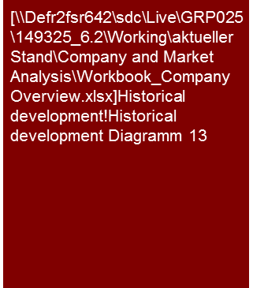



5. Key financials – Historical development
Company Overview
8
[major drivers, extraordinary events]
[Comment on balance sheet structure and major sources of financing]
Sales and profitability 2011-2013 (€m)
[major drivers, extraordinary events]
Balance sheet 2011-2013 (€m)
[major drivers, extraordinary events]
EBITDA-Margin:
6.7%
12.2%
14.6%
16.8%
[major drivers, extraordinary events]
[major drivers, extraordinary events]
Working capital 2011-2013 (€m)
Cash flow2011-2013 (€m)
Net Working Capital:
Free Cash Flow:
16.6
16.9
14.3
13.2
33.5
40.1
60.3
Compulsory content for two years back and the current financial year:
Sales & profitability
Balance sheet structure
Working Capital
Cash flow
This is a sample commentary text.
Adapt as applicable.

Slide 26
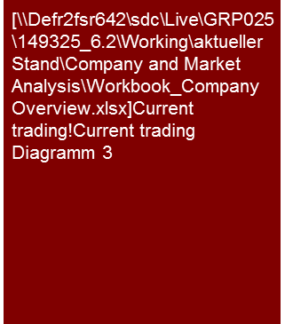
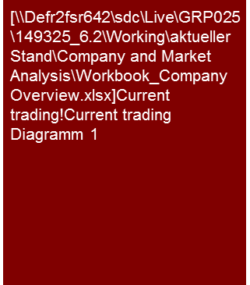
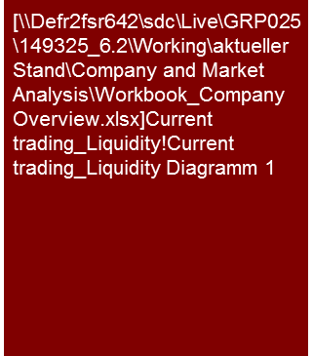

5. Key financials – Current trading
Company Overview
8
[major drivers, extraordinary events]
[RES: Comment on short term liquidity]
Sales, EBITDA and annual result 2012 and FC 2013 (€m)
Balance sheet 2012 and FC 2013 (€m)
4 months
FY
4 months
FY
Assets
Liabilities
Cash Flow 2012 and FC 2013 (€m)
Free liquidity 2012 and FC 2013 (€m)
4 months
FY
2012
FC 2013
Shareholder deposits €xxm
Shareholder deposits €xxm
Compulsory content for the current trading period and comparative FY data:
Sales & profitability
Balance sheet structure
Working Capital
Cash flow
Further content
Liquidity
This is a sample commentary text.
Adapt as applicable.
Turnaround/Rapid transformation [RES only]
Note: Balancing as per German Commercial Code .
Source: Company data; KPMG analysis.

Slide 27
6. Stage of crisis and its causes
Type of crisis
Signs of crisis
Company Overview
RES/Rapid transformation only
9
Delays in the sales processes of the segments xxx and xxxx as well as growth-related capital requirements of the xxxx collide with the currently contractually agreed repayment structures for the debt.
A standstill was reached with the financing consortium of banks until 1 January 20xx.
Stakeholder crisis
Strategy crisis
Product and
sales crisis
Success crisis
Liquidity crisis
Insolvency
Conflicts between stakeholders (amongst others management (management, employees, shareholders)
No clearly defined strategic guideline
Blockades/Polari-zations within management and supervisory levels
Insufficient innovation policy with regard to the product portfolio
Poor investments
Poor diversifications
Poor choice of locations
Strategic gaps in the handling the market
Structural deficits in the organization (here: Loss of strategic partner for the implementation of the strategy)
Drop in demand for the main sales and success products
Shrinking/ Stagnating markets
Increase in binding of capital
High variety of products and complexity
Capacity not utilized
Loss of market shares
Drop in returns
Difficulties in the procurement of funding needed for sustainable restructuring
No coverage of equity costs
Strong fluctuations in profits
Financing structure heightens crisis
Decrease in demand, drop in price and increase in costs per unit produced
Payment difficulties (active creditor mgmt.)
Foreseeable lack of liquidity
Inability to service capital
Goods supplied with advance payments
Risk of the existence of the company/Risk of bankruptcy
Insolvency
Threatened lack of solvency
Over-indebtedness
No assurance of the continuation of the company
✓
✓
✓
✓
✓
✓
✓
✓
✓
✓
✓
✓
✓
✓
✓
✓
✓
Note: Signs of crisis affecting xxxx
Stage of crisis does not apply
Applies completely
Source: Company data

Slide 28
© 2017 KPMG International Cooperative (“KPMG International”). KPMG International provides no client services and is a Swiss entity with which the independent member firms of the KPMG network are affiliated.

